Slide 1
Re-thinking in shock resuscitation endpoints
Echocardiographic Approach to Shock
Rasoul Azarfarin
Prof. of Anesthesiology MD, FACC
Rajaie Cardiovascular Medical & Rearch Center
Jan 18 2019

Slide 2
Definition of Shock
Inadequate oxygen delivery to meet metabolic demands
Results in global tissue hypoperfusion and metabolic acidosis
Shock can occur with a normal blood pressure and hypotension can occur without shock

Slide 3
Definition of Cardiogenic shock
Cardiogenic shock is a state of systemic hypotension persisting >30minutes, with reduced end-organ perfusion due to low cardiac output despite adequate filling pressures.

Slide 4
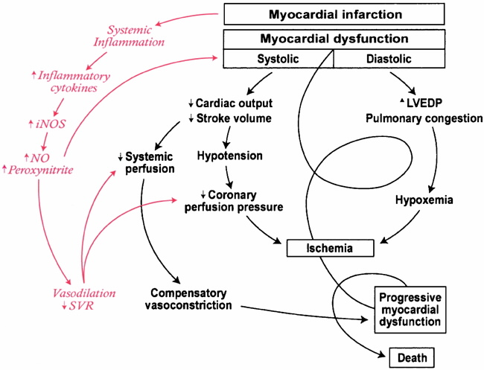
Pathophysiology of CS: Downward Spiral

Slide 5
History: Who gets Cardiogenic Shock?

Slide 6
Re-thinking resuscitation: leaving blood pressure cosmetics behind and moving forward to permissive hypotension and a tissue perfusion-based approach

Slide 7
Shock Endpoints
HEMODYNAMIC ENDPOINTS
  Mean arterial pressure
  Central venous pressure, pulmonary artery catheters, and pulse contour wave analysis
  Mixed and central venous oxygen saturation
  Echocardiography
METABOLIC ENDPOINTS
  Lactate
  Base deficit, pH
  New metabolic markers: a disintegrin and metalloproteinase with a thrombospondin type 1 motif, member 13 (ADAMTS13), heat shock protein 27 (HSP27), and soluble P-selectin (sP-selectin)
Regional endpoints
  Gastric tonometry
  sublingual capnography
  Near-infrared spectrometry (NIRS)

Slide 8
Definitions of shock to be reconsidered
Definitions of shock and resuscitation endpoints traditionally focus on blood pressures and cardiac output.
This carries a high risk of overemphasizing systemic hemodynamics at the cost of tissue perfusion.
In line with novel shock definitions and evidence of the lack of a correlation between macro- and microcirculation in shock, we recommend that macrocirculatory resuscitation endpoints, particularly arterial and central venous pressure as well as cardiac output, be reconsidered

Slide 9
individual and context-sensitive mean arterial blood pressure
In this viewpoint article, we propose a three-step approach of resuscitation endpoints in shock of all origins.
This approach targets only a minimum individual and context-sensitive mean arterial blood pressure (for example, 45 to 50 mm Hg) to preserve heart and brain perfusion. Further resuscitation is exclusively guided by endpoints of tissue perfusion irrespectively of the presence of arterial hypotension ('permissive hypotension').
Finally, optimization of individual tissue (for example, renal) perfusion is targeted. Prospective clinical studies are necessary to confirm the postulated benefits of targeting these resuscitation endpoints.

Slide 10
Resuscitation Endpoints
Restoration of tissue perfusion is the ultimate goal of resuscitation.
Current recommendations suggest targeting:
a mean arterial blood pressure of at least 65 mm Hg
central venous pressure of 8 to 12 mm Hg
central venous oxygen saturation of at least 70%
urine output of at least 0.5 mL/kg per hour

Slide 11
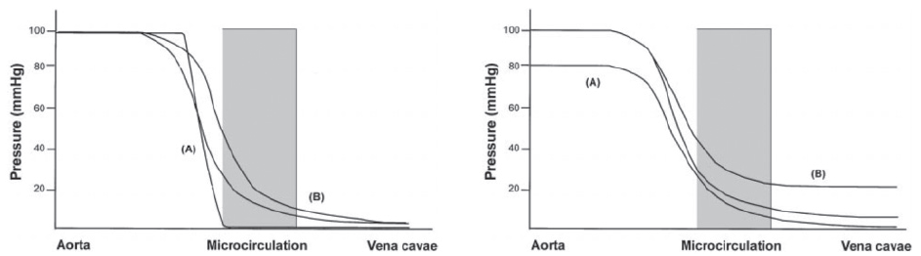
Pitfalls of arterial and central venous blood pressures as resuscitation endpoints
Figure 1. Hydrostatic pressures in circulation. Microcirculation pressure is indicated by shaded area. Values shown to the left and right indicate arterial and venous portions of circulation, respectively. Unlabeled solid curve in both frames represents a normal pressure profile. Left panel: curve A represents maximal arteriolar constriction, and curve B represents arteriolar dilation. Right panel: curves A and B represent decreasing arterial and increasing venous pressures, respectively. Reprinted with permission from the American Physiological Society
Notes:
z

Slide 12
Although critical arterial blood pressure levels have been proposed for diverse shock populations, the inter-individual variation of the correlation between arterial pressure and systemic blood flow is substantial

Slide 13
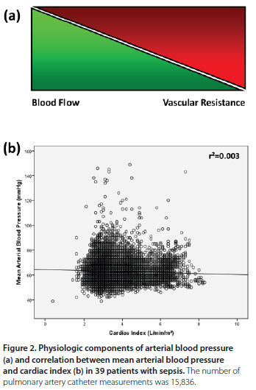

Slide 14
Normalization of blood pressure with the use of a vasoconstrictor, such as phenylephrine, without concomitant increases in blood flow during cardiopulmonary bypass deteriorated microcirculatory perfusion.
Tissue hypoperfusion in shock may further be aggravated by vasopressors used to achieve a specific arterial blood pressure – progressive hypoperfusion may even be (mis)interpreted as irreversible shock. When high vasopressor doses are deemed necessary, mortality is excessively high and continued treatment has been considered futile.

Slide 15
Accordingly, mortality was 100% in septic shock patients who received norepinephrine of more than 0.5 μg/kg/minute despite signs of peripheral hypoperfusion .
Similarly, vasodilatory shock patients who exhibited ischemic skin lesions and received vasopressin to achieve a mean arterial blood pressure of at least 60 mm Hg had an extremely high mortality.

Slide 16
In support of a poor correlation between macrocirculatory endpoints and tissue perfusion in shock, the majority of critically ill patients with sepsis continued to exhibit signs of tissue hypoperfusion despite reaching macrocirculatory endpoints (for example, mean arterial blood pressure of at least 65 mm Hg and central venous pressure of at least 8 mm Hg)

Slide 17
Physiological principles of tissue perfusion
In contrast to common beliefs, tissue and microcirculatory perfusion is physiologically regulated by changes in blood flow and not arterial blood pressure. Under physiological and most pathophysiological conditions, regulation of blood flow occurs autonomously in the tissues and is driven by metabolic demand .
Vasoactive end products (for example, adenosine, potassium, and protons) and other vasoregulatory mediators (for example, nitric oxide and adrenomedullin) released into the capillary bed and a reduced post-capillary partial oxygen tension result in arteriolar dilatation through direct and indirect mechanisms (venular-arteriolar feedback)

Slide 18
Only when systemic blood flow can no longer increase to compensate for peripheral vasodilation and arterial blood pressure starts to decrease does sympathetic control override tissue-driven blood flow regulation.
Reduced stimulation of arterial baroreceptors activates the sympathetic system and results in peripheral vaso-constriction in an attempt to preserve heart and brain perfusion, even if this goes along with global tissue hypoperfusion as observed in shock.

Slide 19
Rethinking resuscitation endpoints
To avoid blood pressure cosmetics and vasopressor overuse in shock, resuscitation endpoints need to be reconsidered.
The authors propose a three-step approach of resuscitation endpoints which is based on growing evidence and physiological considerations

Slide 20
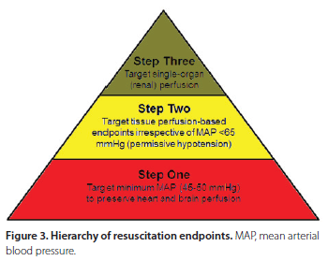

Slide 21
Step one: target a minimum individual and context sensitive arterial blood pressure to preserve heart and brain perfusion
In line with physiological principles, maintenance of heart and brain perfusion represents the primary resuscitation goal. Although arterial blood pressure does not accurately predict global tissue perfusion, it correlates well with coronary and cerebral blood flow.
In contrast to current recommendations, our clinical experience suggests that lower mean arterial blood pressures (for example, 45 to 50 mm Hg) are mostly sufficient to adequately perfuse the heart and brain in acute situations.

Slide 22
These observations are in accordance with physiological experiments suggesting a lower threshold of coronary and cerebral autoregulation of 45 to 50 mm Hg mean arterial blood pressure
Even higher arterial blood pressures may be required in patients with primary neurologic pathologies.
Yet clinicians must be aware that such an emergency treatment simply avoids cardiovascular collapse but does not restore (and potentially even worsens) global tissue perfusion.
The assumption that a mean arterial blood pressure of at least 65 mm Hg is generally required to preserve heart and brain perfusion may lead to significant overuse of vasoconstrictors and unnecessary induction of tissue hypoperfusion

Slide 23
Step two: target tissue perfusion-based endpoints
resuscitation endpoints targeted during this phase must reflect adequacy of global tissue perfusion. Despite numerous attempts to identify an accurate endpoint of microcirculatory perfusion
Until reliable markers have been identified, the authors suggest applying the following pragmatic indirect/downstream markers of tissue perfusion as resuscitation endpoints: arterial lactate, peripheral perfusion, urine output, or venous oxygen saturation
We advise measuring all variables (for example, central/mixed venous oxygen saturation, peripheral perfusion index, and tissue oxygen saturation) at regular intervals or, whenever possible, continuously.

Slide 24
In patients in whom vital organ and global tissue perfusion is improving or has been restored, macro-hemodynamic variables such as arterial blood pressure and cardiac output appear to be of minor importance.
in a critically ill patient who passes sufficient amounts of urine, who has good peripheral perfusion, whose lactate levels are normal or adequately decreasing, and who exhibits a central/mixed venous oxygen saturation of at least 60%/70%, even very low arterial blood pressures (for example, mean of 45 to 50 mm Hg) can be accepted as long as no signs of cerebral or coronary hypoperfusion arise.
In view of the currently recommended arterial blood pressure target of 65 mmHg, this concept may also be referred to as permissive hypotension.

Slide 25
Physicians should specifically adopt this concept when caring for patients in severe shock on high vasopressor support.
Reducing vasopressor doses, in creasing systemic blood flow by fluid and inotrope therapy while accepting mean arterial blood pressures just above the lower cerebral/coronary autoregulation limit (for example, 45 to 50 mm Hg) is often the only way to reverse advanced shock, restore tissue perfusion, and facilitate survival

Slide 26
Step three: target markers of single-organ perfusion
Only if global tissue perfusion is restored should optimization of single-organ perfusion be considered. This, however, needs to be critically weighed against the potential risks of intensifying catecholamine therapy.
Particularly in patients with severe shock, restoration of global tissue perfusion may require intense fluid and catecholamine therapy and thus may not allow focusing on tertiary resuscitation endpoints.
Given that of all internal organs the kidneys have the poorest capability to adjust to reductions in blood flow, optimizing single-organ perfusion is, in most patients, equivalent to optimizing renal perfusion.

Slide 27
Sonographic determination of the renal resistive index may help to optimally adjust vascular tone to improve kidney perfusion.
During attempts to optimize single organ/renal perfusion, maintenance of tissue perfusion based endpoints needs to be guaranteed and the risk/ benefit ratio of further increases of vasopressor doses must be critically weighed.

Slide 28
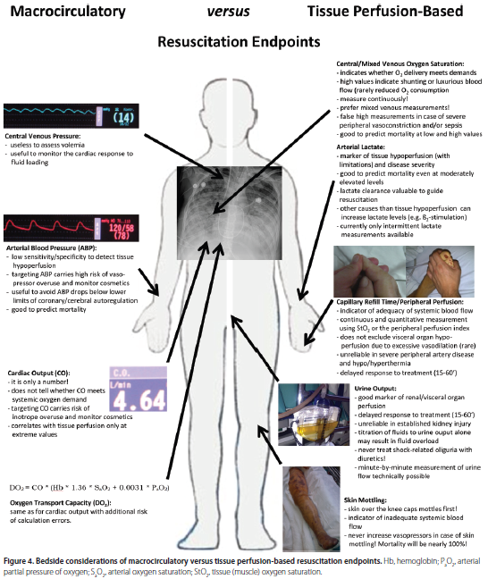

Slide 30
Types of Shock
Hypovolemic
Septic
Cardiogenic
Anaphylactic
Neurogenic
Obstructive

Slide 31
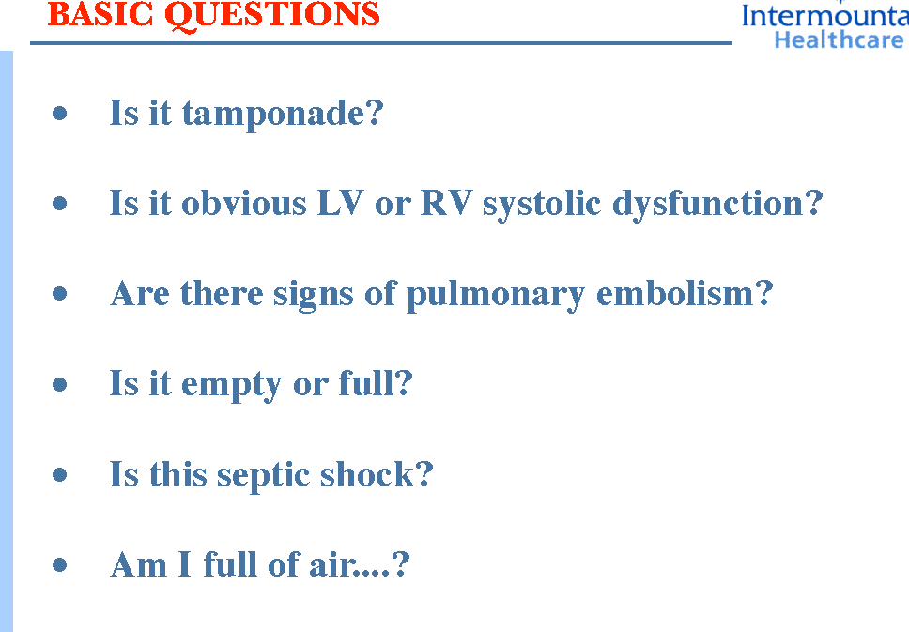

Slide 32
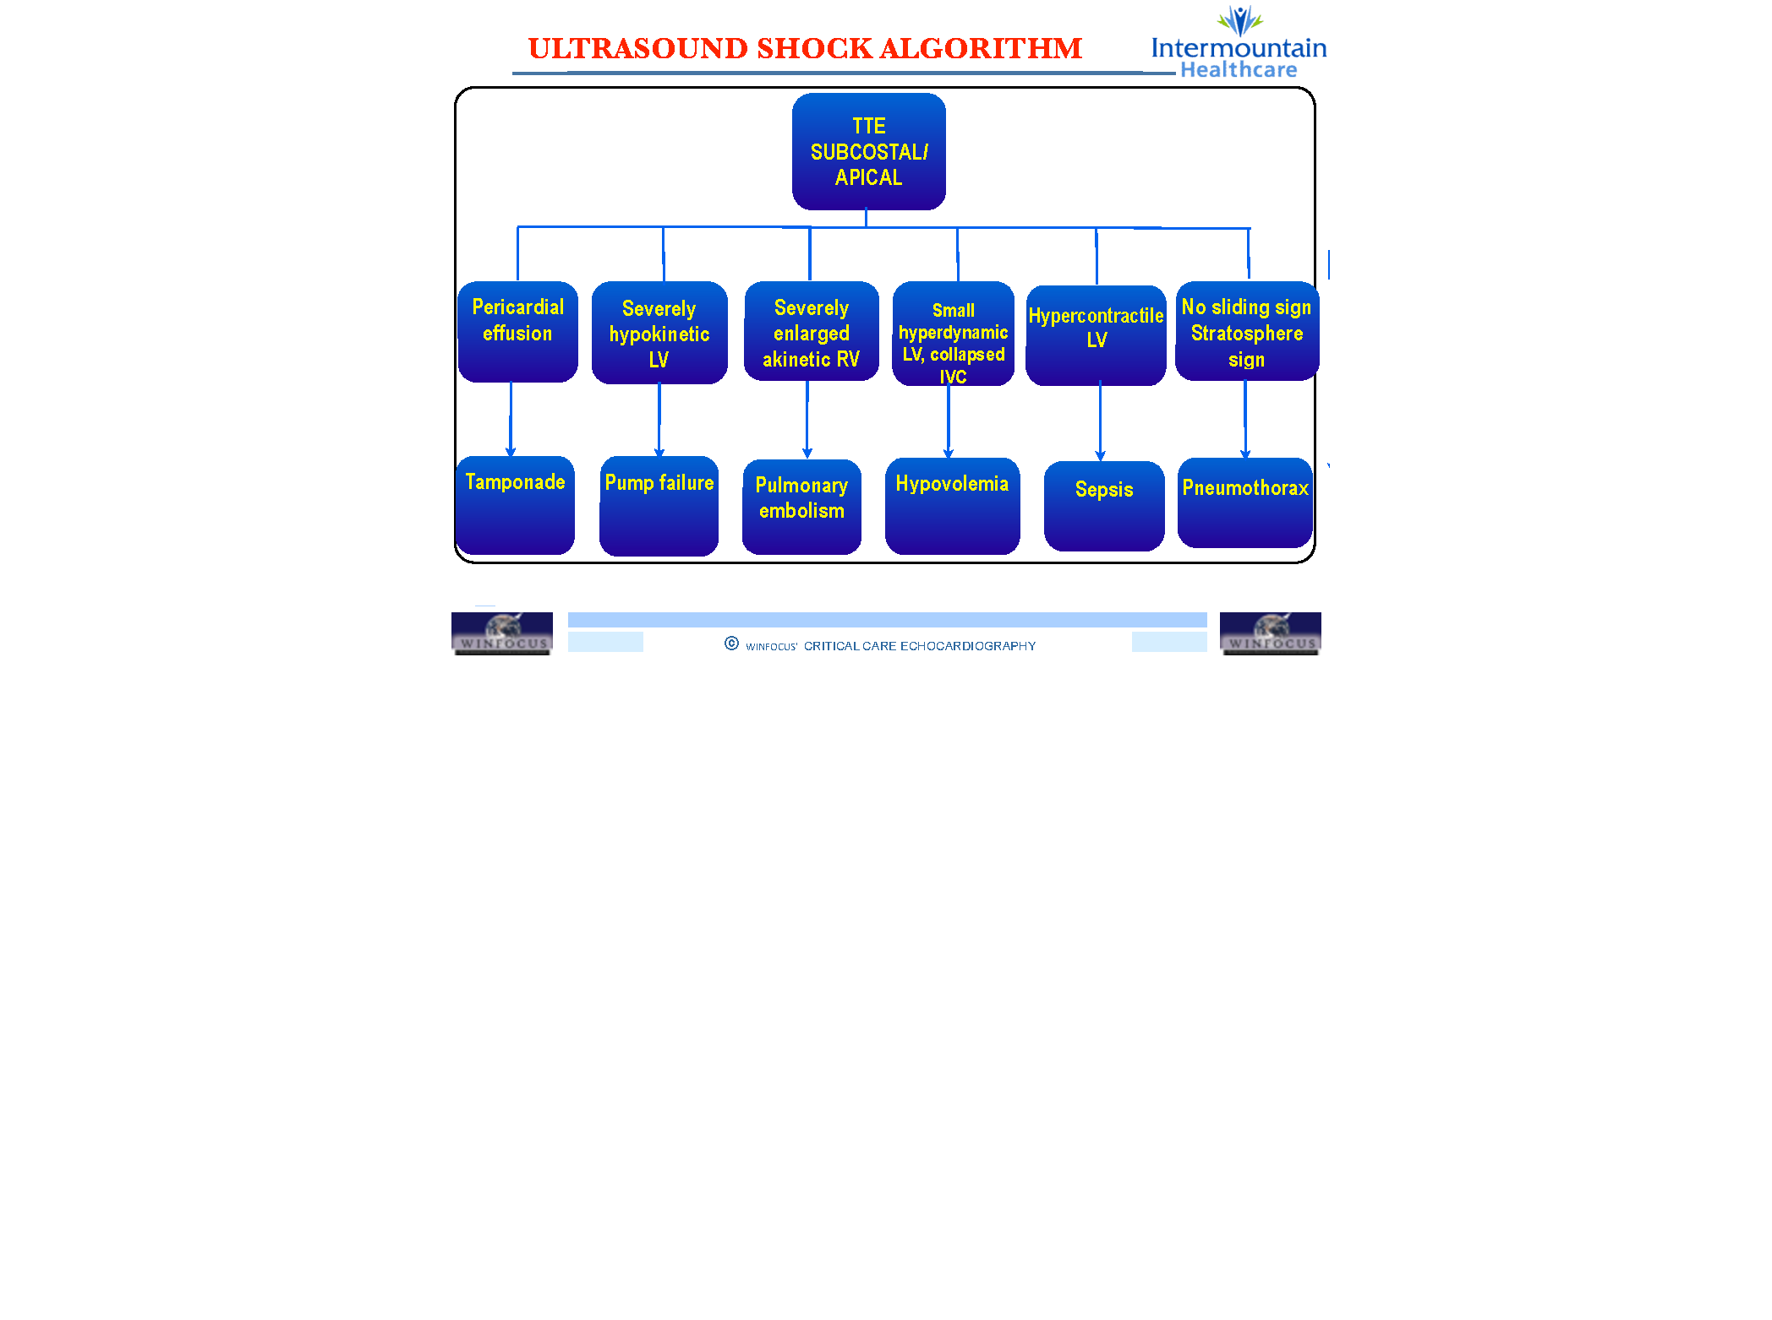

Slide 33
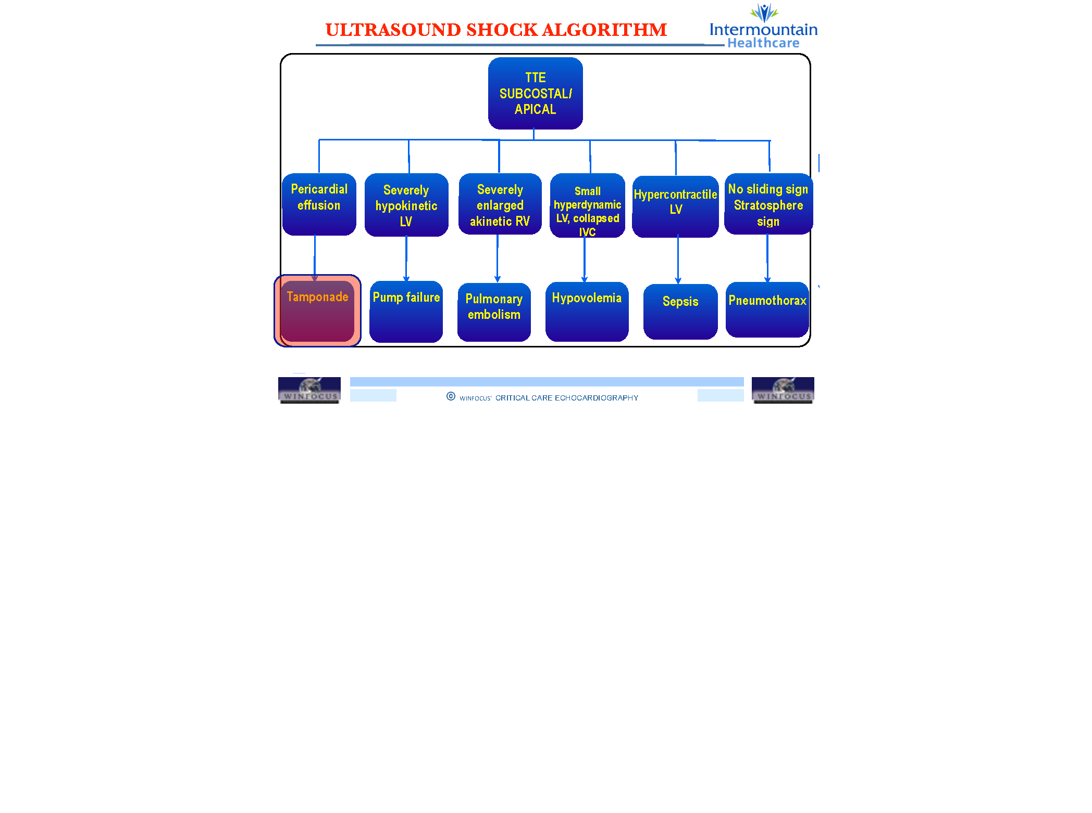

Slide 34
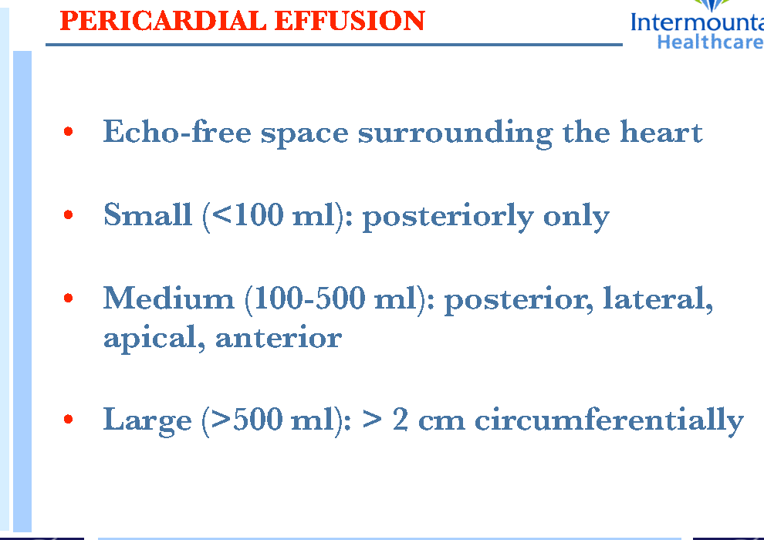

Slide 35
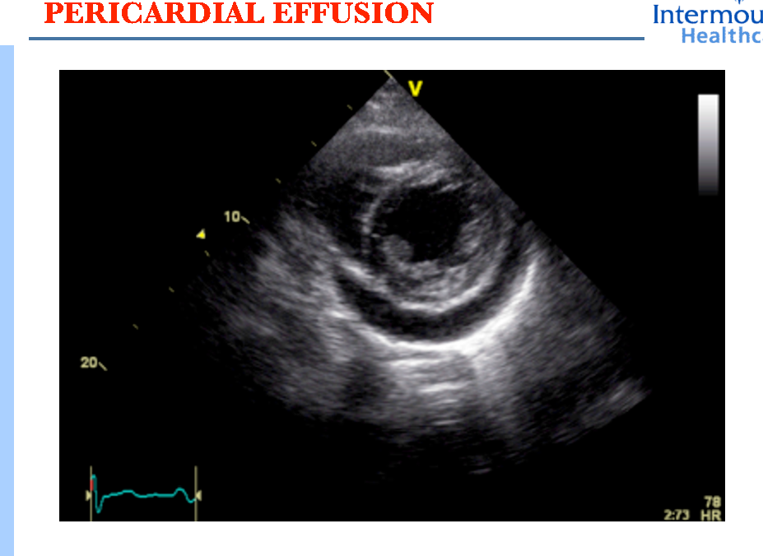

Slide 36
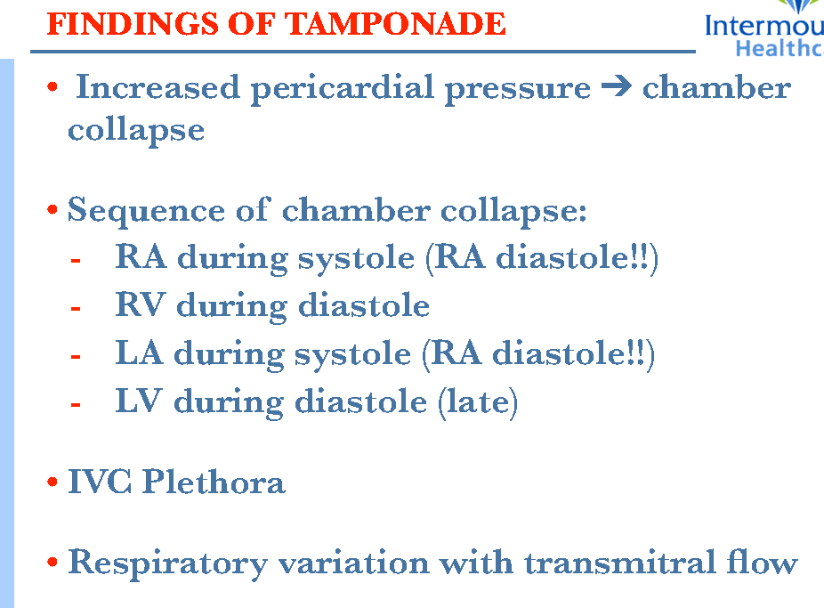

Slide 37
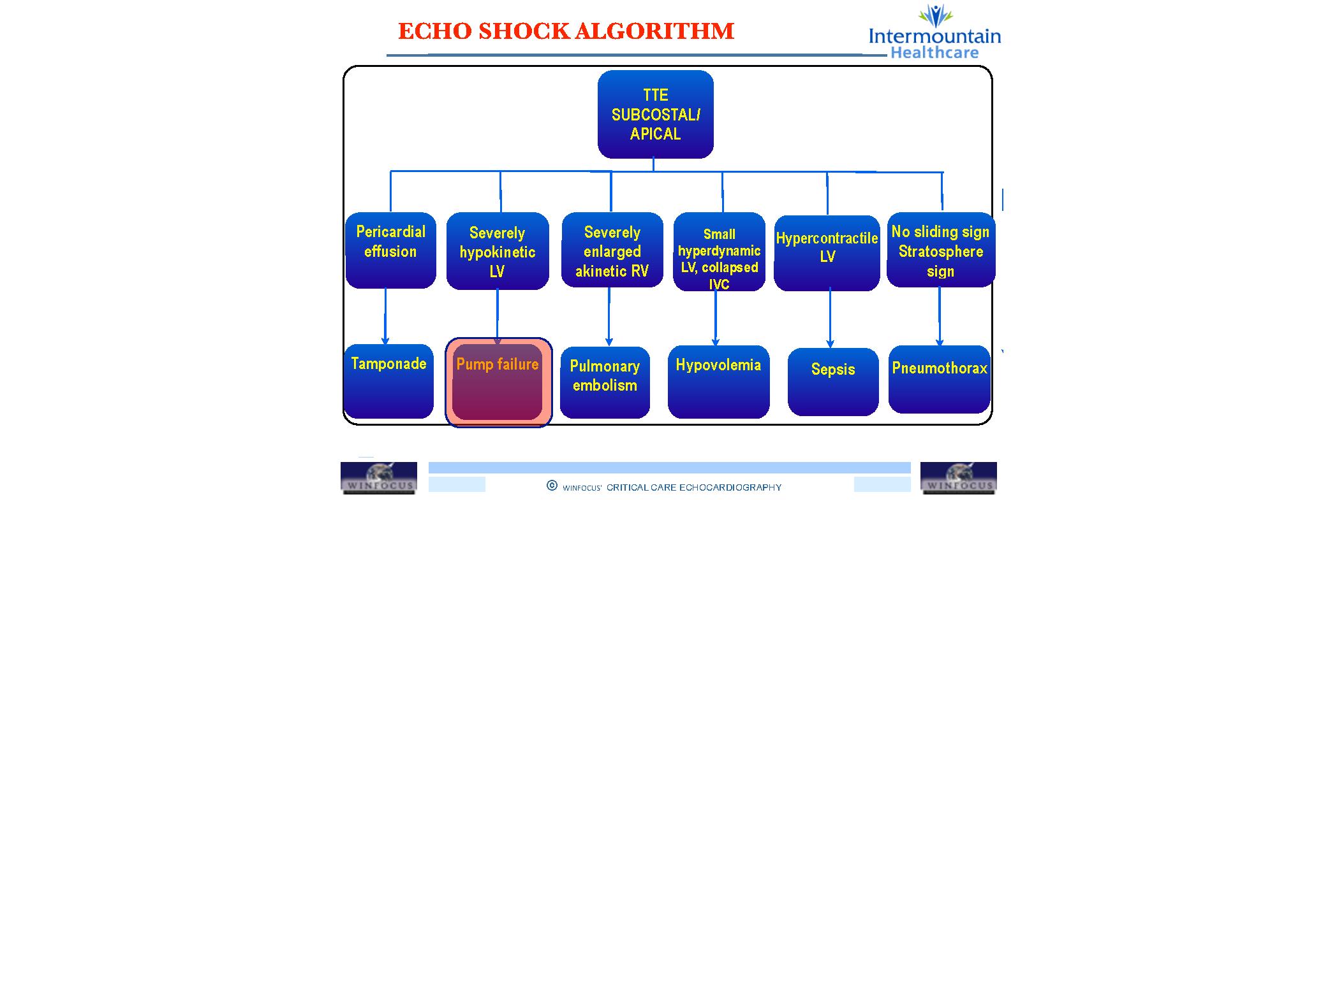

Slide 38
Crateria of Cardiogenic Shock
Persistent (>30 minutes) hypotension with systolic arterial pressure< 90 mmHg
Reduction in cardiac index <2.2 L/min/m2
Presence of elevated left ventricle filling pressure(PCWP >18 mm Hg)
Signs and symptoms of end organ hypoperfusion (restlessness,confusion,cold cyanotic extremeties,oliguria

Slide 39
Physical Exam: Hemodynamic Profiles in Heart Failure
Congestion at Rest
No
Yes
Signs of congestion
Orthopnea/PND
JVD
Ascites
Edema
Rales (not always)
Warm & Dry
5%
Warm & Wet
70%
No
Low
Perfusion
at Rest
Yes
Cold & Dry
5%
Cold & Wet
20%
Evidence of low perfusion
Narrow pulse pressure
Altered mental status
Low serum sodium
Cool extremities
Hypotension with ACE inhibitor
Renal insufficiency
Stevenson LW. Eur J Heart Fail. 1999;1:251
Notes:
Hemodynamic Profile Assessment
The hemodynamic profiles of patients with advanced HF are shown above. The majority (90%) of patients presenting with ADHF are volume overloaded (wet). These patients may have a cardiac index that is unchanged or decreased. Most patients with a decreased cardiac index have SVR, although a minority have unchanged or low SVR.
The signs and symptoms of congestion include orthopnea, jugular venous distention, and peripheral edema. Signs and symptoms of low perfusion include narrow pulse pressure, cool extremities, and decreased mental status.
Stevenson LW. Eur J Heart Fail. 1999;1:251

Slide 40
Vasopressors and Inotropes
Goal: optimize perfusion while minimizing toxicity
Close monitoring of mixed venous saturation
Invasive hemodynamic monitoring (arterial line, cardiac output monitoring) to guide therapy
Inotropes: shift Frank-starling curve to a higher plateau (increased contractility)
Low output syndrome without shock: start with an inotrope such as dobutamine
Low output syndrome with shock: start with dopamine or norepinephrine

Slide 41
Cardiogenic Shock
Defined as:
  SBP < 90 mmHg
  CI < 2.2 L/m/m²
  PCWP > 18 mmHg
Signs:
  Cool, mottled skin
  Tachypnea
  Hypotension
  Altered mental status
  Narrowed pulse pressure
  Rales, murmur

Slide 42
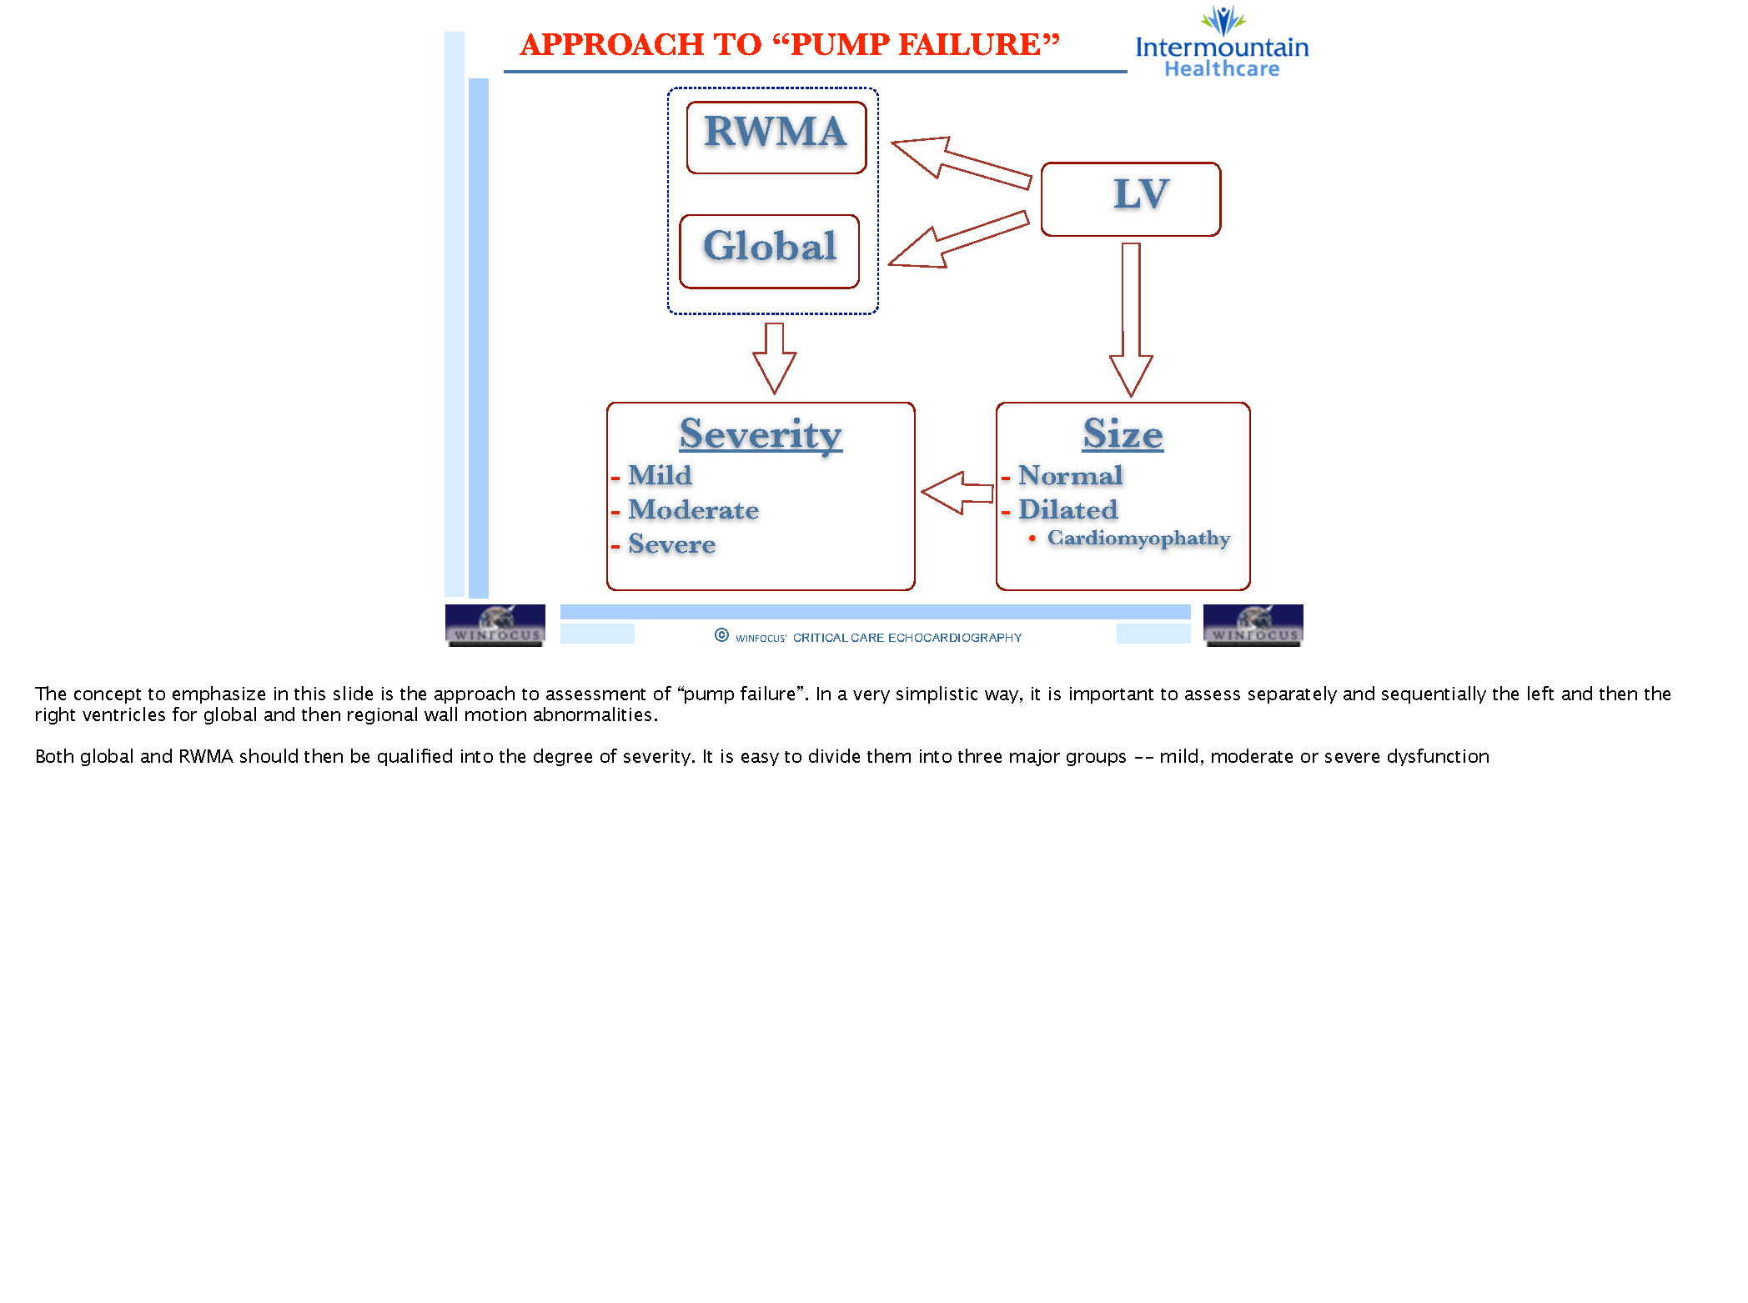

Slide 43
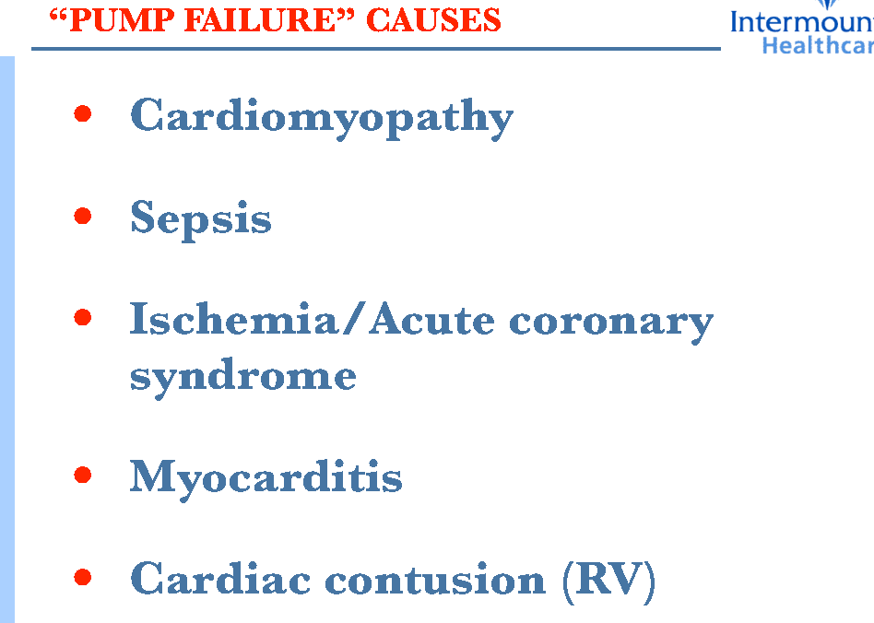

Slide 44
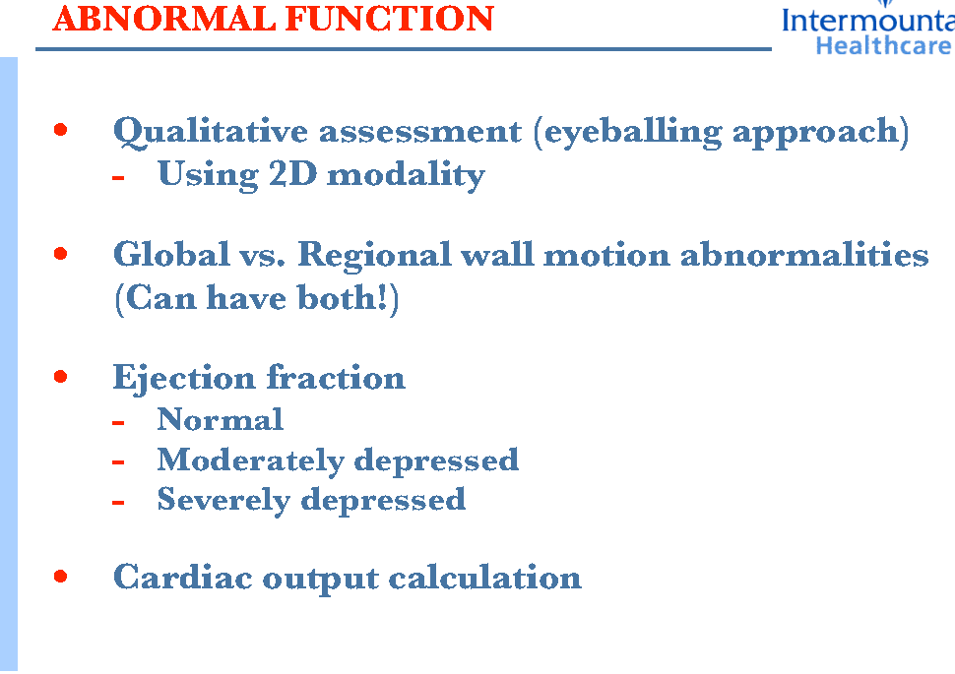

Slide 45
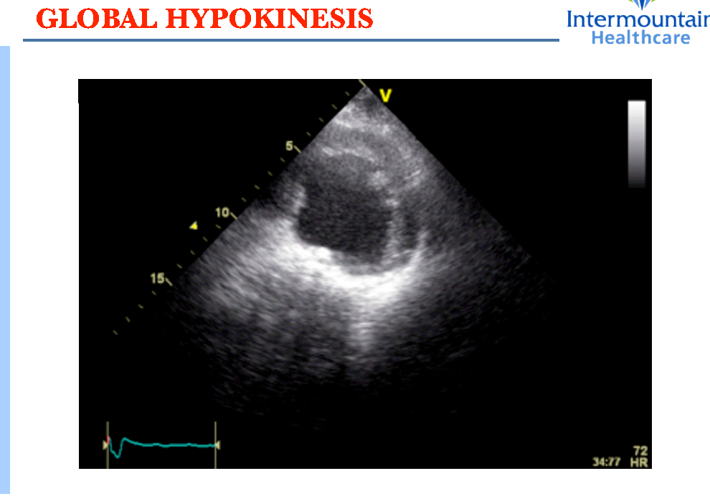

Slide 46
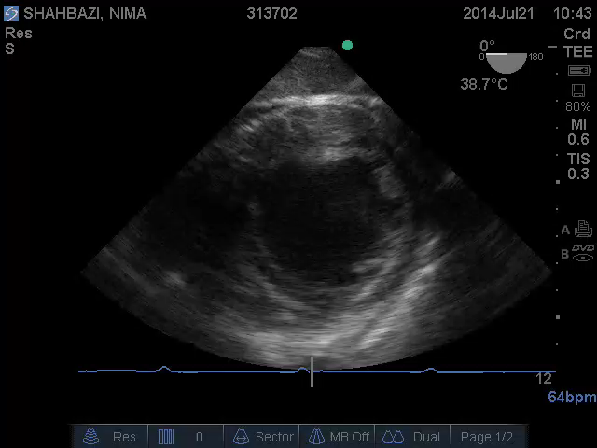
Global LV Dysfunction

Slide 47
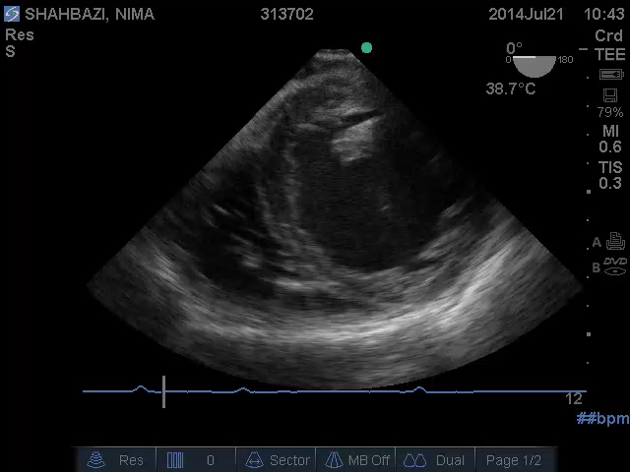
Global LV Dysfunction

Slide 48
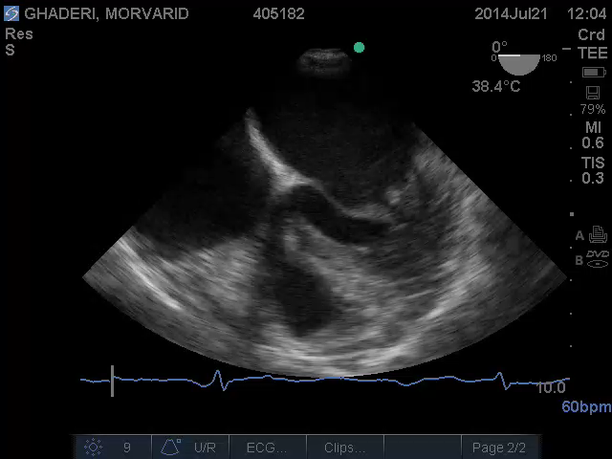
Global LV Dysfunction

Slide 49
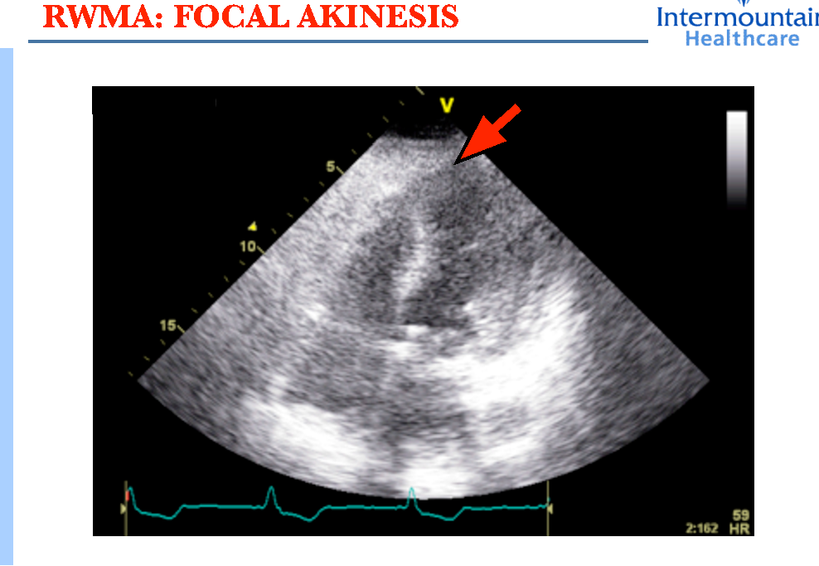

Slide 50
Step 3: Estimate LAP (High > 15 mmHg)
Diastolic dysfunction?
High LAP
Normal LAP
Low LAP
In general terms, the trend in PCWP is in the same direction as the change in inter-atrial septal pattern.

Slide 51
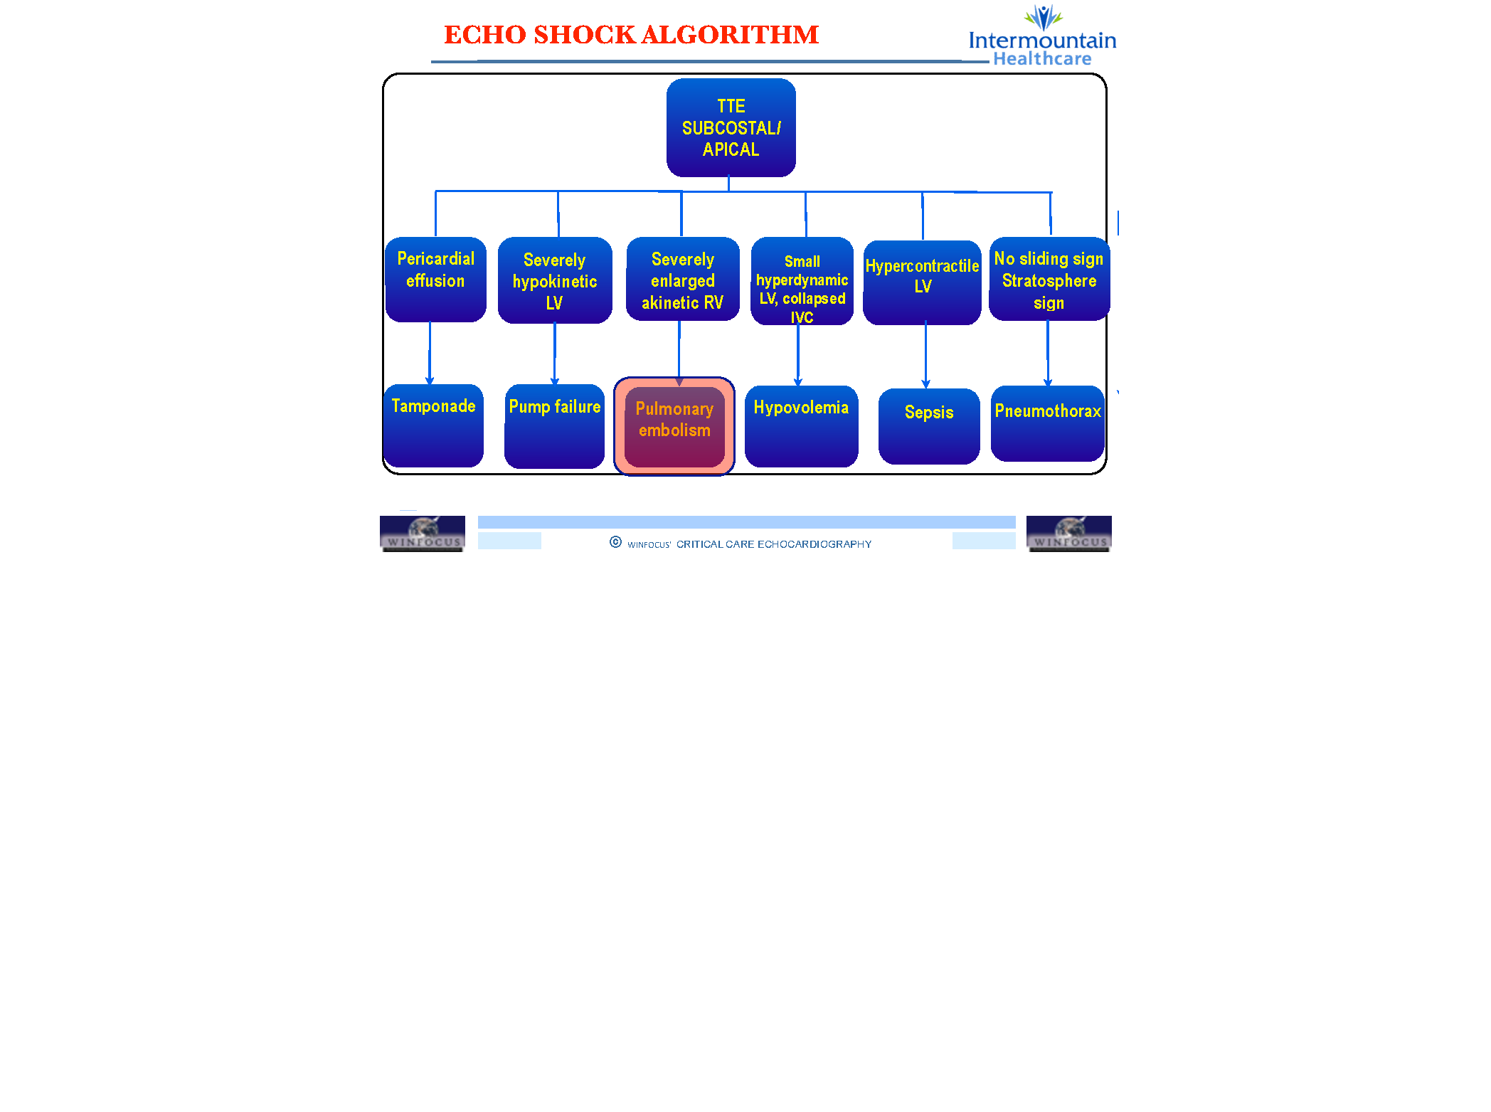

Slide 52
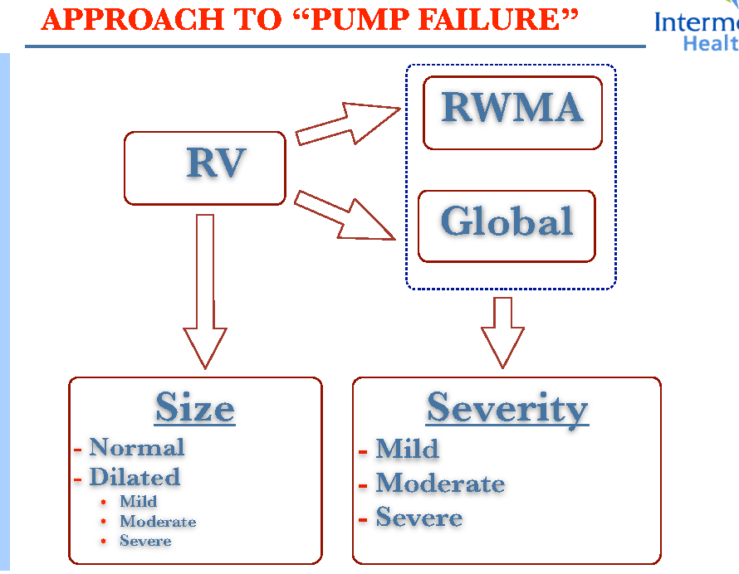

Slide 53
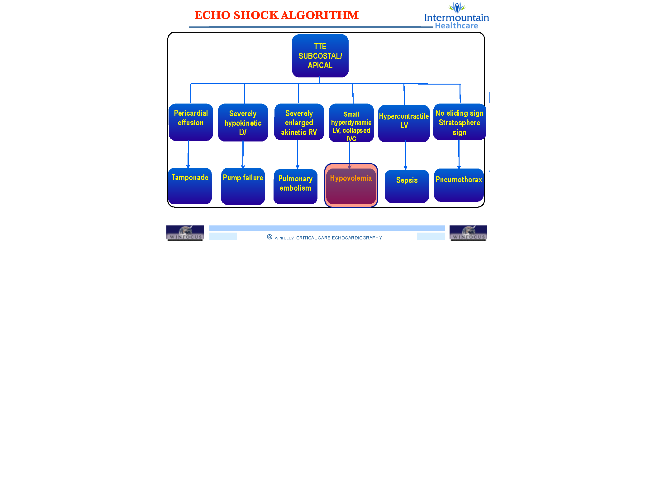

Slide 54
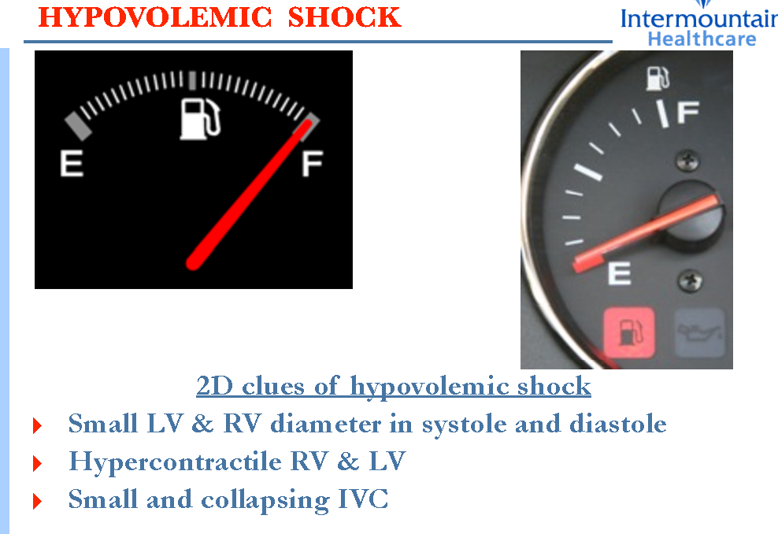

Slide 55
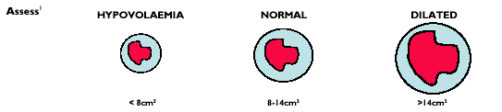
Step 1: Estimate Left Ventricular End Diastolic Volume (Preload) / LVEDA
normal range of LVEDA= 8-14 cm²
An LVEDA < 8 cm² is consistent with hypovolaemia, and
LVEDA > 14 cm², consistent with a dilated left ventricle

Slide 56
Step 2: Estimate Systolic Function
LVESA [FAC]
FAC= (EDA – ESA) / EDA
.Increased (FAC > 65%)
.Normal (FAC 50-65%)
.Reduced (<50%).

Slide 57
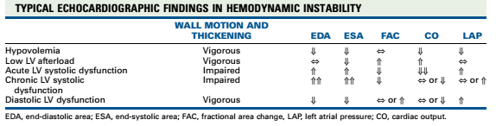
With low LV afterload cardiac index is usually
high (>3.5 L/min/m²), whereas with hypovolemia
cardiac index is usually low (<2.5 L/min/m²)

Slide 58
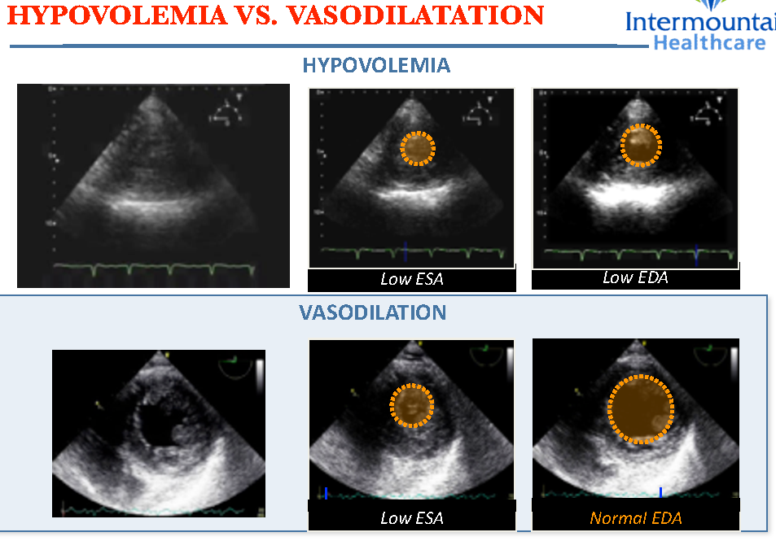

Slide 59
Semiquantative (Visual: eyeballing) method of assessing ventricular function
LV contraction is visualised in the entire standard transthoracic 2-D imaging planes:
PLAX & PSAX view
AP4Ch & AP2Ch view
Apical long axis (Aplax) view
subcostal long (Sublax) and short axis (Subsax) views
The grading of the global systolic contraction can be described as:
normal
reduced
severely reduced

Slide 60
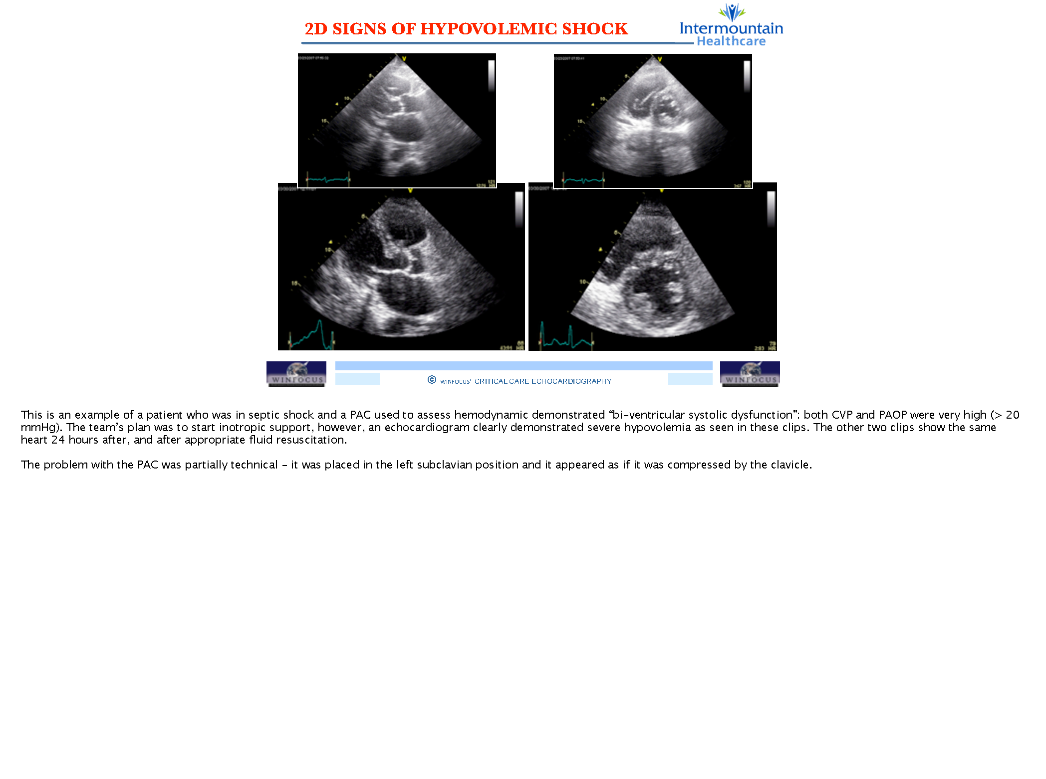

Slide 61
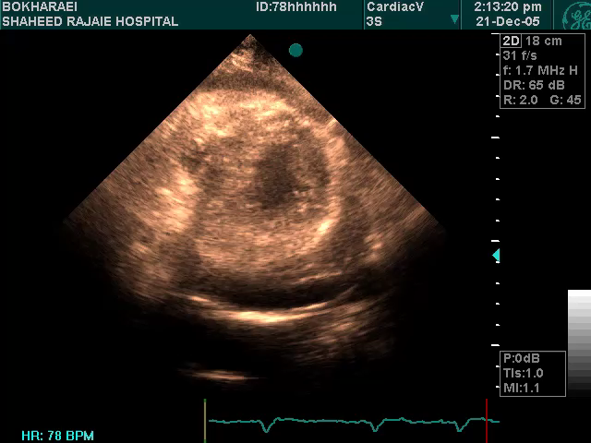
RV Rupture+ PE

Slide 62
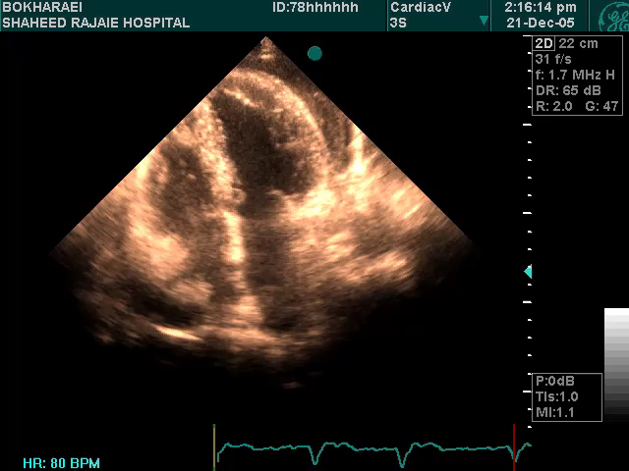
RV Rupture+ PE

Slide 63
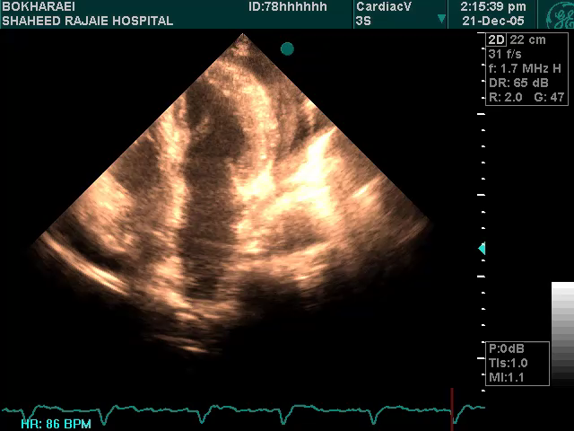
RV Rupture+ PE

Slide 64
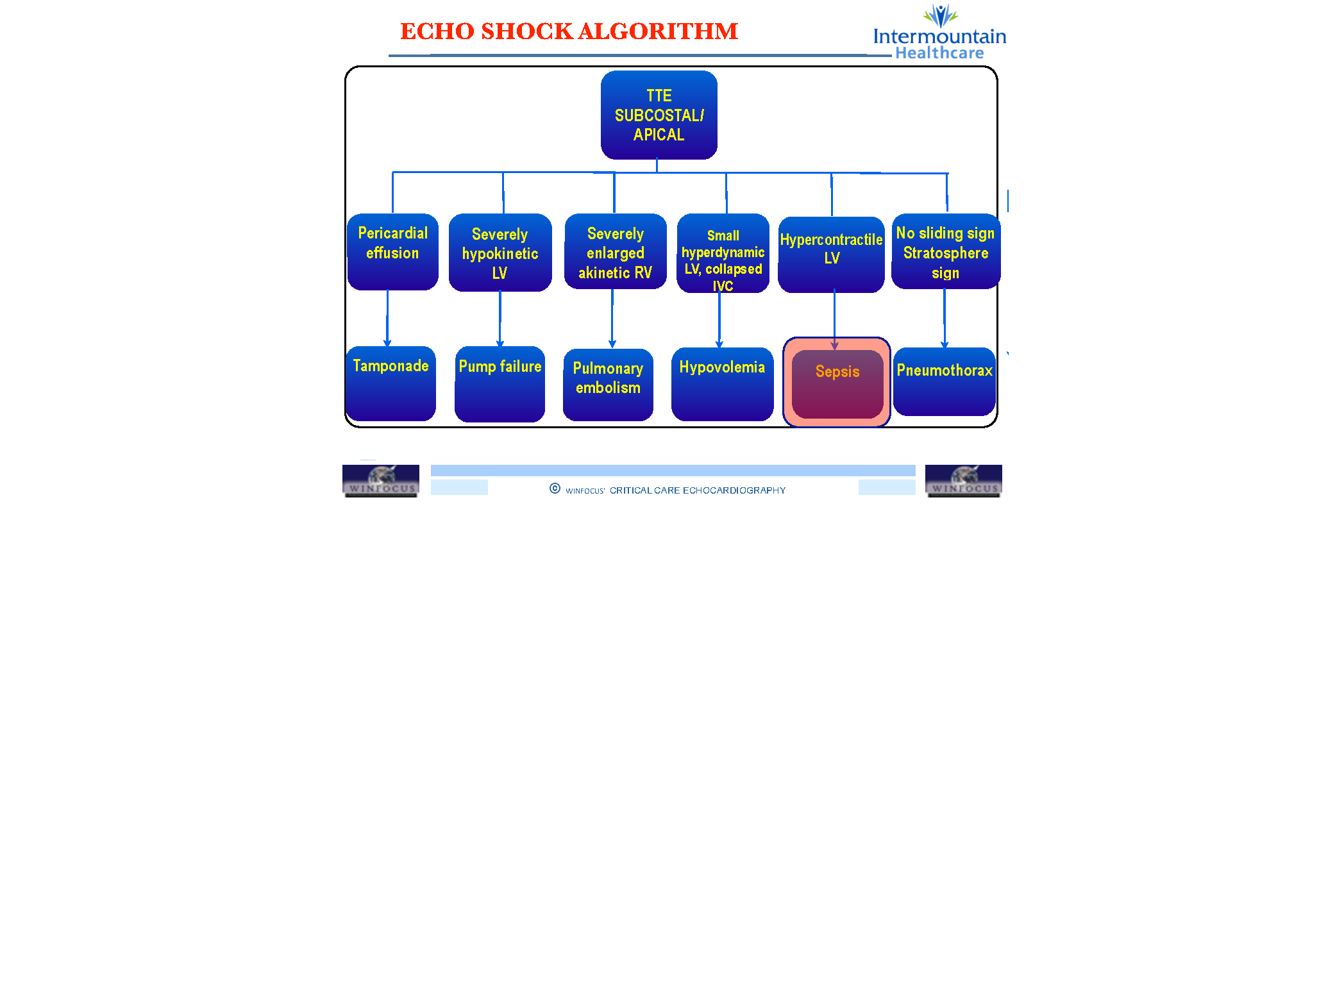

Slide 65
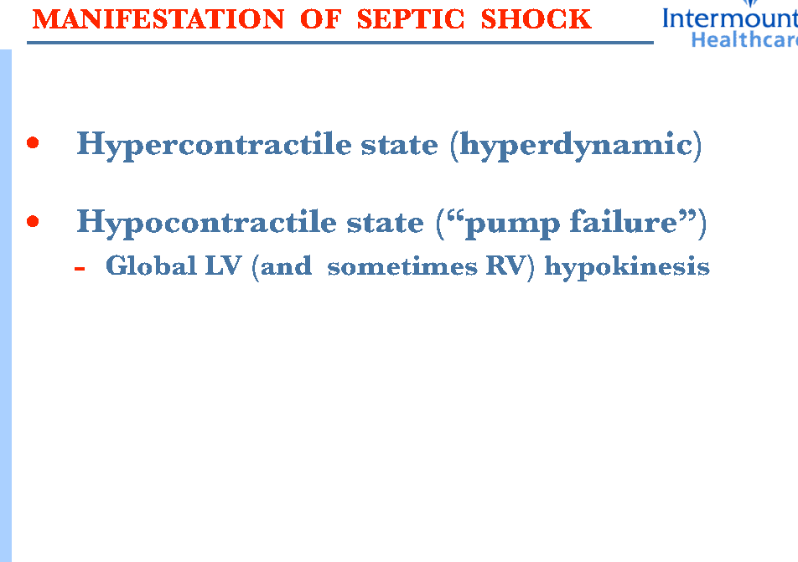

Slide 66
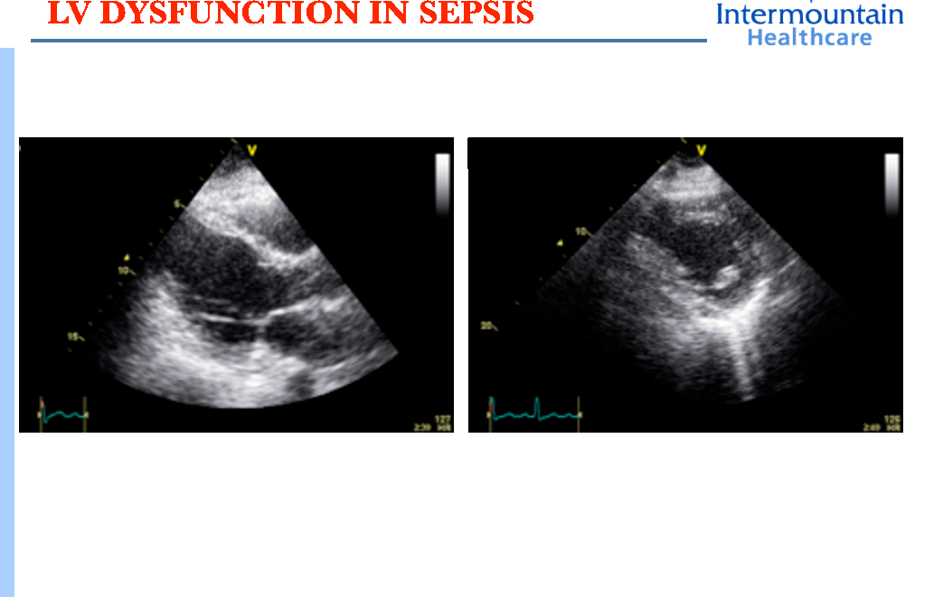

Slide 67
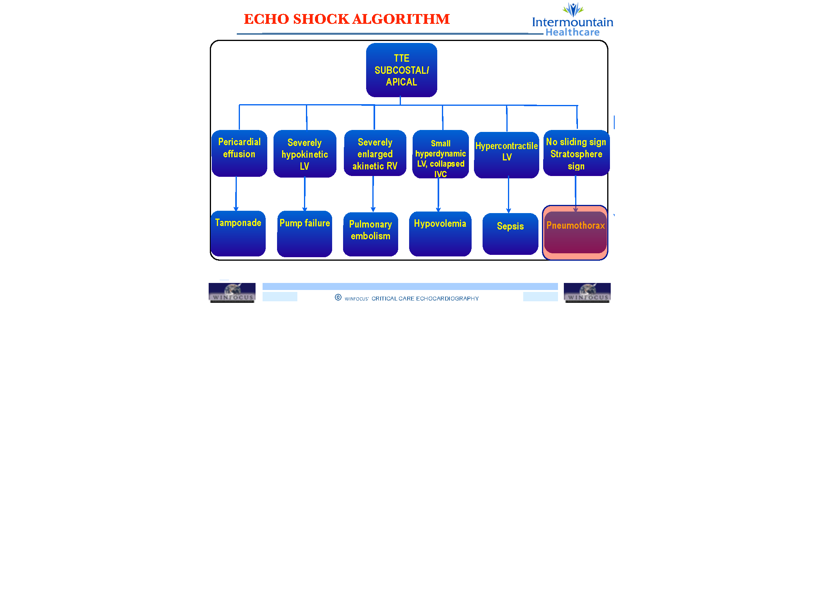

Slide 68
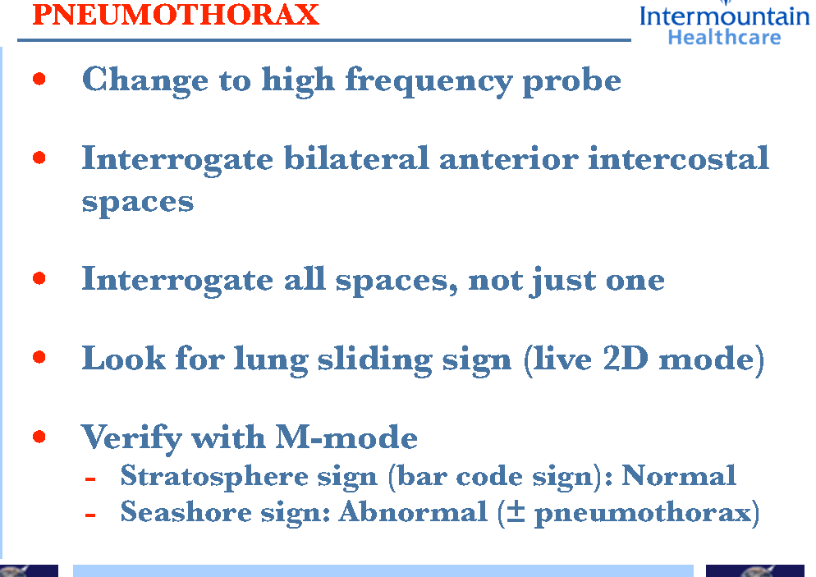

Slide 69
